Slide 1

2024 US Census Data
Mitchell Sydlowski
University of Mount Union
DSC 140
December 6,2024

Slide 2
Required Analysis
Mean, St Dev, Range of Numerical Data
Relationships Between Continuous and Categorical Data
Machine Learning Algorithm

Slide 3
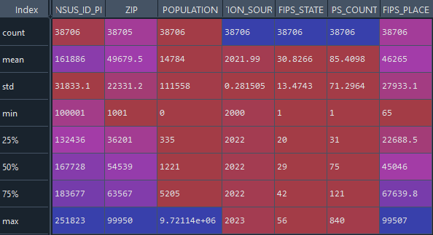

Mean, St Dev, Range

Slide 4
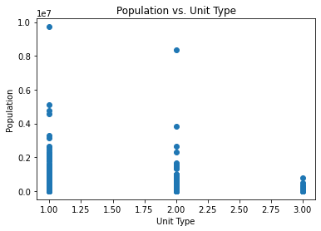
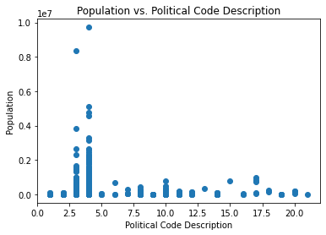
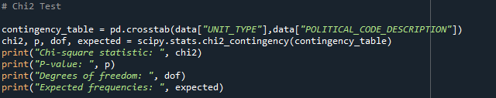
Continuous & Categorical Data
Correlation Score: -0.163
Chi-Square Statistic: 68,611
Correlation Score: -0.109

Slide 5
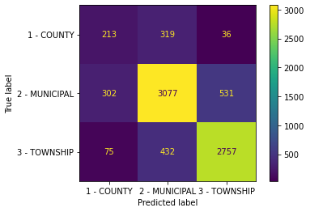
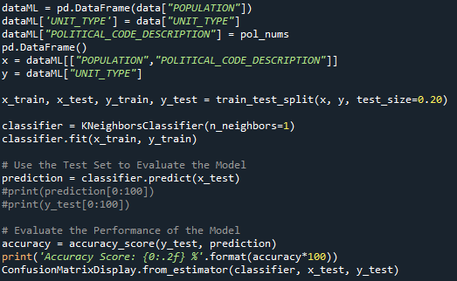
Machine Learning Algorithm
Accuracy Score: 77 – 78 %

Slide 6
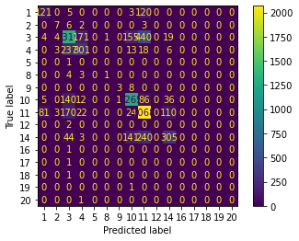
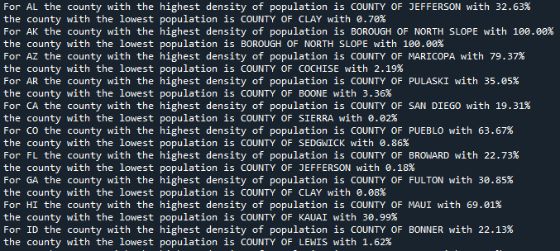
Research Questions: Which counties hold the largest and smallest percentage of each state's population? Based on Population, Unit Type, and Zip Code, can a ML Algorithm predict Political Code Description?

